Slide 1
Time Series Analysis for Stock Price Prediction of
Indus Tower Limited
Supervised by,
Prof. Amit Mitra
Presented by,
• Souvik Bhattacharyya(201433)
• Rachita Mondal (201374)
• Shreya Pramanik (201415)
• Arkaprova Saha (201278)
• Bimal Roy (201292)

Slide 2
Objective
The aim of our work is to apply relevant concepts of Time Series Analysis for daily closing stock price prediction of Indus Tower Limited. At first we tried to predict the mean behavior of the data set using appropriate AR, MA and ARIMA models. Thereafter, we have used Hybrid ARIMA-ARCH and Hybrid ARIMA-GARCH to capture the volatility of the series.

Slide 3
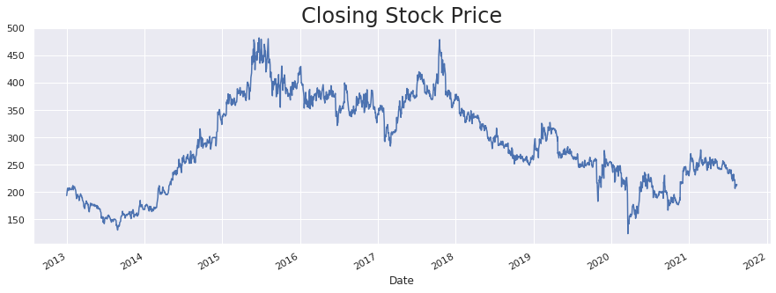
Data
The data on Daily Closing Stock Price of Indus Tower Limited has been collected for 31-12-2012 to 13-08-2021 from Yahoo Finance.

Slide 4
Elimination of Deterministic Components

Slide 5
Components of Time Series
• Trend: Smooth Long term movement in a time series
• Seasonal Variation: Periodic movement of a time series with period less than a year
•Cyclical Variation: : Long term periodic movement of a time series with period more than a year
• Irregular Variation : Random Component

Slide 6
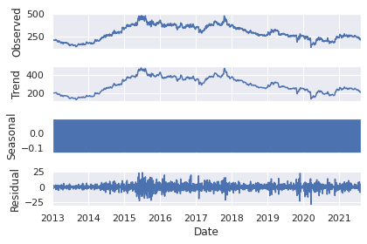
Decomposition of the Data
From the above graph it can be observed that there is a presence of trend components in the collected data. Next we will use some statistical tests to have a strong conclusion regarding the nature of the data.

Slide 7


•Kwiatkowski-Phillips-Schmidth-Shinn (KPSS) test for
Stationarity:
P_value : 0.01 < 0.05.
Hence, we reject the null hypothesis at 5% level of significance and conclude on the basis of the given data that the data is not stationary.
• Mann-kendal Test for existence of Trend:
P_value : 2.22e-16 < 0.05.
Hence, we reject the null hypothesis at 5% level of significance and conclude on the basis of the given data that there exists trend component in our data.

Slide 8
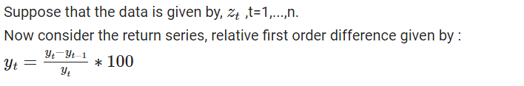
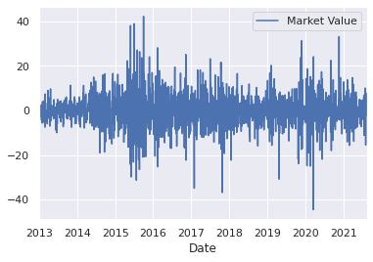
Elimination of Trend
On performing KPSS test on the return series we get,
P_value : 0.1 > 0.05
So, the return series does not contain any significance deterministic component. Therefore, the stationary series is given by:

Slide 9
Linear Statistical Models for Time Domain Analysis
• Moving Average (MA)
• Auto-Regressive (AR)
• Auto-Regressive Integrated Moving Average (ARIMA)

Slide 10
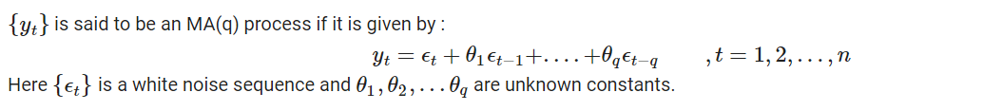
Moving Average (MA)
In order to select appropriate order we will plot the sample Auto Correlation Function(ACF). The population auto-covariance of an MA(q) process becomes zero after lag q.

Slide 11
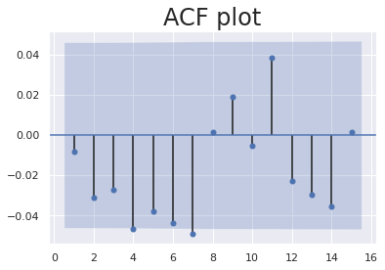
• ACF Plot:
The ACF plot has spikes up to lag 7. So we fix our maximum allowable model order to be 8. We will fit an MA(8) model and choose appropriate model on the basis of the significance of the coefficients of appropriate lags.

Slide 12
• Order Selection:
Lags | Coefficients | P_value
1 | -0.0180 | 0.446
2 | -0.0377 | 0.110
3 | -0.0327 | 0.169
4 | -0.0477 | 0.046
5 | -0.0399 | 0.098
6 | -0.0473 | 0.052
7 | -0.0536 | 0.030
8 | -0.0020 | 0.933
The p_value corresponding to the coefficient of lag 8 is 0.933 > 0.05,
whereas the p_value corresponding to lag 7 is 0.03 < 0.05.
As the lag 8 coefficient is insignificant we select the model order to be 7.

Slide 13
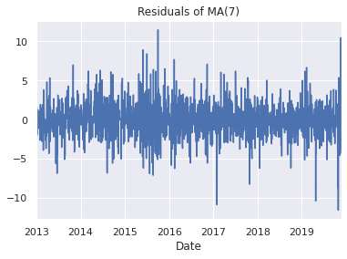
• Residual analysis:
The residuals of MA(7) exhibits a random pattern.

Slide 14
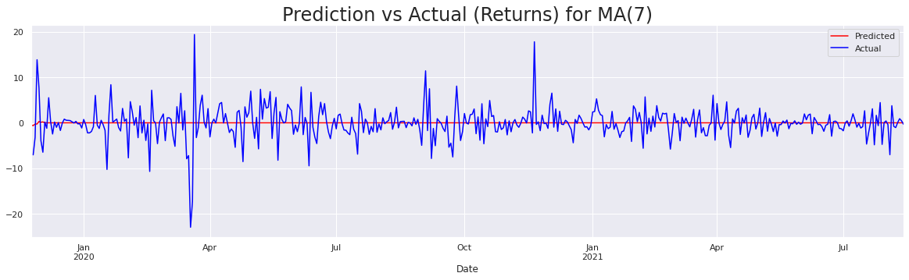
• Prediction by MA(7) on test data set:

Slide 15
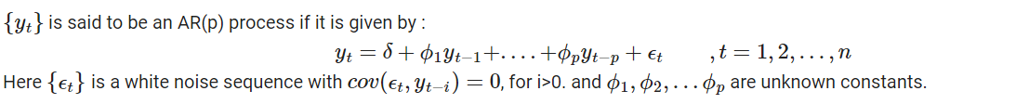
Auto Regressive (AR)
In order to select appropriate order we will plot the sample Partial Auto Correlation Function(PACF). The population partial auto-covariance of an AR(p) process becomes zero after lag p.

Slide 16
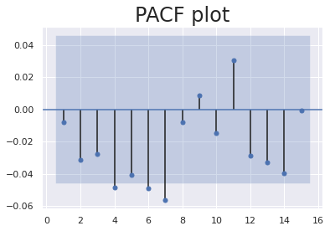
• PACF Plot:
The PACF plot has spikes up to lag 7. So we fix our maximum allowable model order to be 8. We will fit an AR(8) model and choose appropriate model on the basis of the significance of the coefficients of appropriate lags.

Slide 17
• Order Selection:
Lags | Coefficients | P_value
1 | -0.0178 | 0.451
2 | -0.0392 | 0.096
3 | -0.0338 | 0.152
4 | -0.0532 | 0.025
5 | -0.0447 | 0.060
6 | -0.0509 | 0.033
7 | -0.0573 | 0.016
8 | -0.0077 | 0.749
The p_value corresponding to the coefficient of lag 8 is 0.749 > 0.05,
whereas the p_value corresponding to lag 7 is 0.016 < 0.05.
As the lag 8 coefficient is insignificant we select the model order to be 7.

Slide 18

• Residual analysis:
The residuals of AR(7) exhibits a random pattern.

Slide 19

• Prediction by AR(7) on test data set:

Slide 20
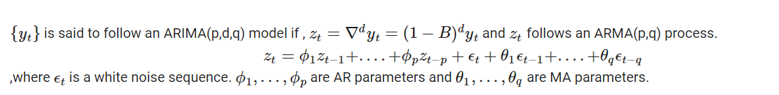
Auto Regressive Integrated Moving Average (ARIMA)
Using minimum AIC criteria the chosen ARIMA model is ARIMA(2,0,1). As expected the parameter corresponding to degree of differencing is zero. Hence the ARIMA(2,0,1) model is equivalent to an ARMA(2,1) model.

Slide 21
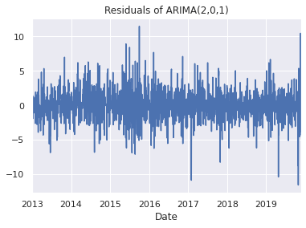
• Residual Series:
The residuals of ARIMA(2,0,1) exhibits a random pattern.

Slide 22
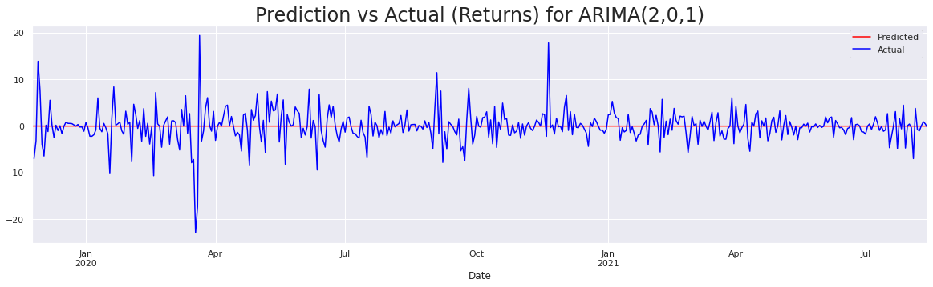
• Prediction by ARIMA(2,0,1) on test data set:

Slide 23
Non-linear Statistical Models
• Autoregressive Conditional Heteroskadastic (ARCH)
• Generalized Autoregressive Conditional Heteroskadastic (GARCH) (GARCH)

Slide 24
Modeling stock price in time series focuses mainly on modeling and predicting the mean behavior of the data. But a major role is played by the played by the daily risk and uncertainty considerations in stock price management. It has necessitated the formulation of new time series techniques that allow for the modeling of time varying variances. The Autoregressive Conditional Heteroskadasticity (ARCH) type models give us an appropriate basis for studying this problem.

Slide 25
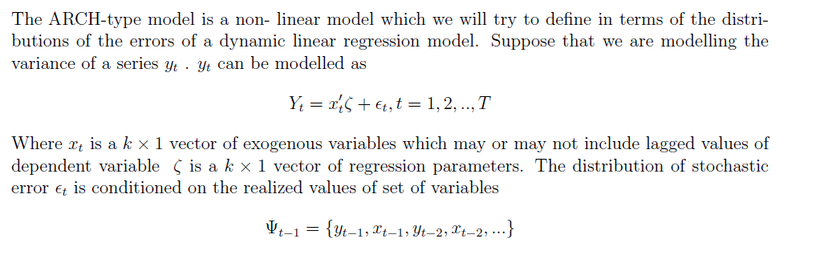
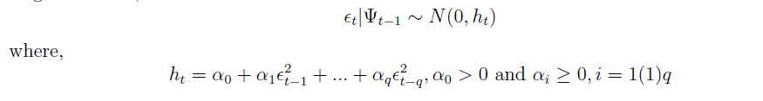
ARCH Model
• General Definition:
In our case we will use Hybrid ARIMA-ARCH model for the purpose of volatility prediction of the return series.

Slide 26
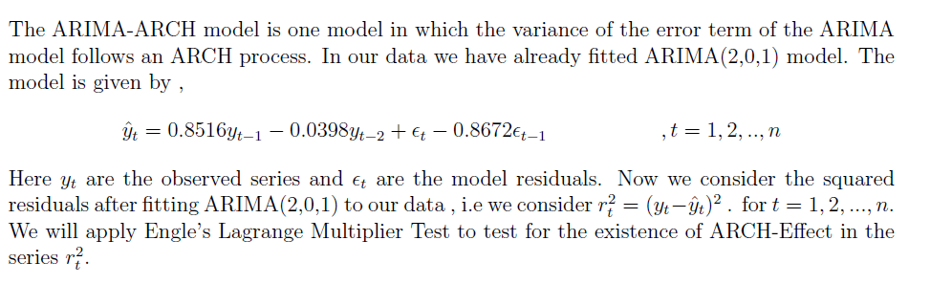
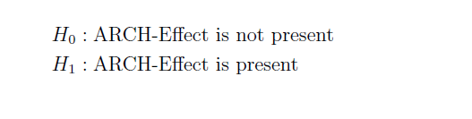
Hybrid ARIMA-ARCH Model
• Lagrange Multiplier Test:
The p_value of the test is 3.45e−69 < 0.05. Hence at 5% level of significance we reject the null hypothesis and conclude that the squared residual series contains ARCH-effect.

Slide 27
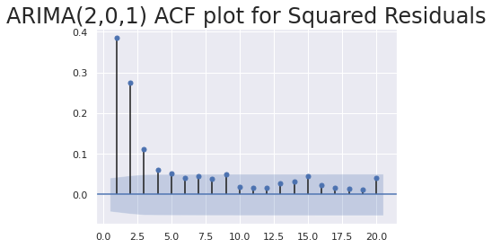
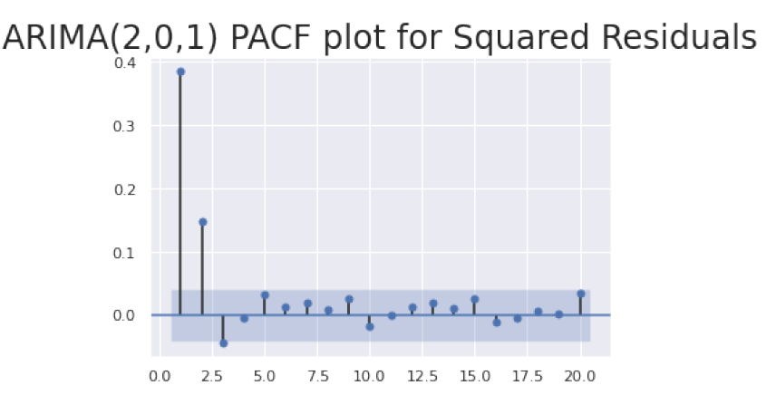
Order Selection of ARCH model
The ACF plot indicates spikes up to order 4 or 5 and the PACF plot indicates spikes up to order 3. Based on the observations we will fit a ARCH(6) model and check for the significance the coefficients of appropriate lags.

Slide 28
The estimates of the coefficients for lags 1,2 and 3 are significant as the p value associated with them are less than 0.05.
On the other hand the for lags greater than 3 the coefficients are not significant.
Hence we resort to fit the model of order 3 to the squared residuals of ARIMA(2,0,1).
Lags | Estimate | P_value
1 | 0.1356 | 5.292e-04
2 | 0.0709 | 4.515e-02
3 | 0.1095 | 1.103e-02
4 | 0.0347 | 0.356
5 | 0.0347 | 0.226
6 | 0.0310 | 0.361

Slide 29
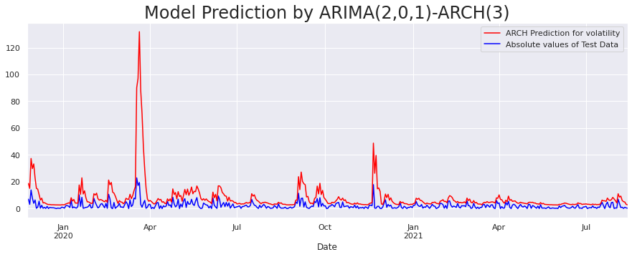
• Volatility Prediction by ARCH(3):

Slide 30
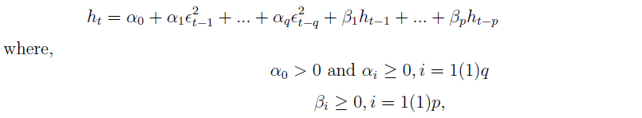
GARCH Model
• General Definition:
Here the conditional variance is modeled as :
This is a GARCH(p,q) process.
Proceeding similarly as we in ARIMA-ARCH we will now build an ARIMA-GARCH model.

Slide 31
Order Selection of GARCH model
• Start with GARCH(1,1):
Parameters | Estimates | P_value
alpha[1] | 0.1109 | 2.531e-03
beta[1] | 0.7722 | 3.817e-23
Both the parameters are significant because the p_values are less than 0.05. Now we proceed to check GARCH(1,2) model.

Slide 32
• GARCH(1,2) model:
Parameters | Estimates | P_value
alpha[1] | 0.1394 | 5.346e-04
beta[1] | 0.2255 | 0.590
beta[2] | 0.5074 | 0.260
beta[2] parameter is not significant as the p_value is greater than 0.05. Hence we fix the second parameter of GARCH model to be 1. Now we proceed to check GARCH(2,1) model.

Slide 33
• GARCH(2,1) model:
Parameters | Estimates | P_value
alpha[1] | 0.1109 | 2.466e-03
alpha[2] | 6.9086e-14 | 1.000
beta[1] | 0.7722 | 1.118e-09
The alpha[2] parameter is insignificant as the p_value is greater than 0.05. Hence we fix the first parameter to be 1. So our final model is a GARCH(1,1) model.

Slide 34
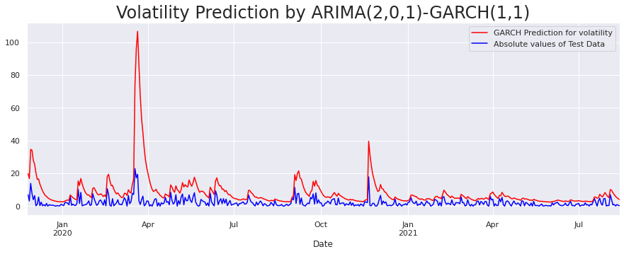
• Volatility prediction by GARCH(1,1):

Slide 35
Conclusion
In this work our central purpose was to predict the closing stock price of the chosen company. Using appropriate methods we have successfully transformed the non-stationary raw data into a stationary one. After that, under the assumption of constant error variance we have identified that the AR(7), MA(7) and ARIMA(2,0,1) models are best to describe the mean nature of the stock price. Later, we detected the presence of ARCH-effect in the ARIMA(2,0,1) residuals through Engle’s Lagrange Multiplier test. To capture the volatility along with the mean we have used the combination of ARIMA and ARCH(GARCH) and fitted Hybrid ARIMA(2,0,1)-ARCH(3) and ARIMA(2,0,1)-GARCH(1,1) to the data.

Slide 36
Thank You

